Slide 1
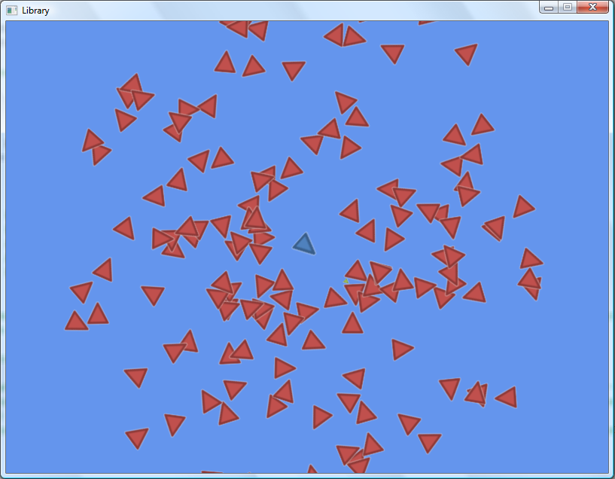
Enemies
Player
Projectile

Slide 2
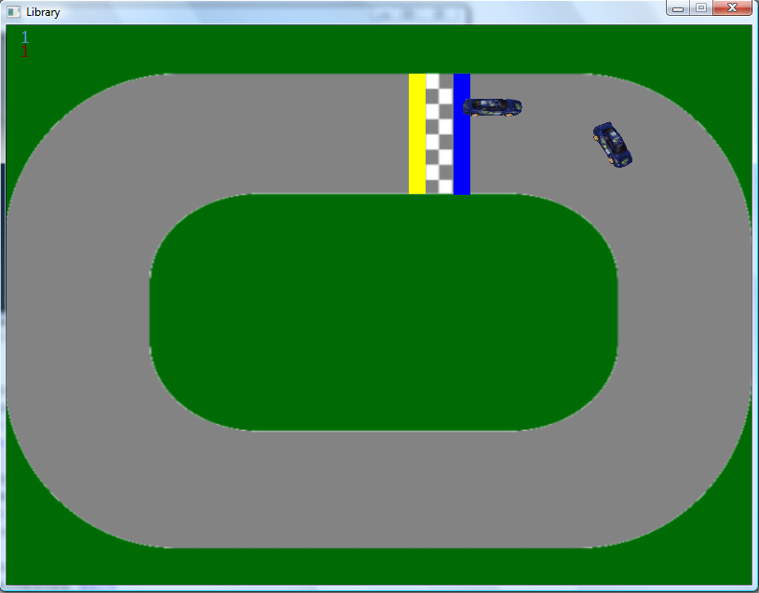
Car Models

